Slide 1

Hotel Cancellations Prediction for Revenue Optimization
By Jahnavi Jammula

Slide 2
Problem Statement
Hotel cancellations are unpredictable and pose significant challenges for revenue management. However, by analysing past cancellation data, hotels can develop predictive models to forecast cancellations and optimize operations.
The key goal of this thesis is to create an accurate predictive model for hotel cancellations using reservation features like lead time, length of stay, daily rate, and special requests. With advanced notice of possible cancellations, hotels can proactively manage inventory, pricing, and staffing to maximize revenue and guest satisfaction. The model provides actionable insights to mitigate financial and reputational risks of last-minute cancellations.
By leveraging predictive analytics, hotels can turn cancellations from a source of uncertainty into an opportunity for competitive advantage and improved financial performance. This thesis presents a data-driven methodology for cancellations forecasting that enables proactive and strategic revenue management.

Slide 3
Dataset Overview:
This Project uses a hotel booking dataset comprising 117,263 records and 33 features, representing information related to reservations, customer behavior, and booking conditions. It includes bookings from City Hotels and Resort Hotels, which helps in the analysis of guest preferences and cancellation trends.
The target variable "is_canceled" identifies whether the booking was canceled-1 or not-0. The significant features are: lead time - time in days before check-in, market segment, deposit type, customer type, and previous cancellations give a pattern in cancellations.
One of the problems was class imbalance: 63% of the bookings were not canceled, and 37% were canceled. SMOTE-Synthetic Minority Over-sampling Technique-was then applied to balance this dataset hence improving the models' performance.
This dataset will shed light into the knowledge which will help the hotels predict cancellations, come up with optimized policies, and reduce revenue loss.

Slide 4
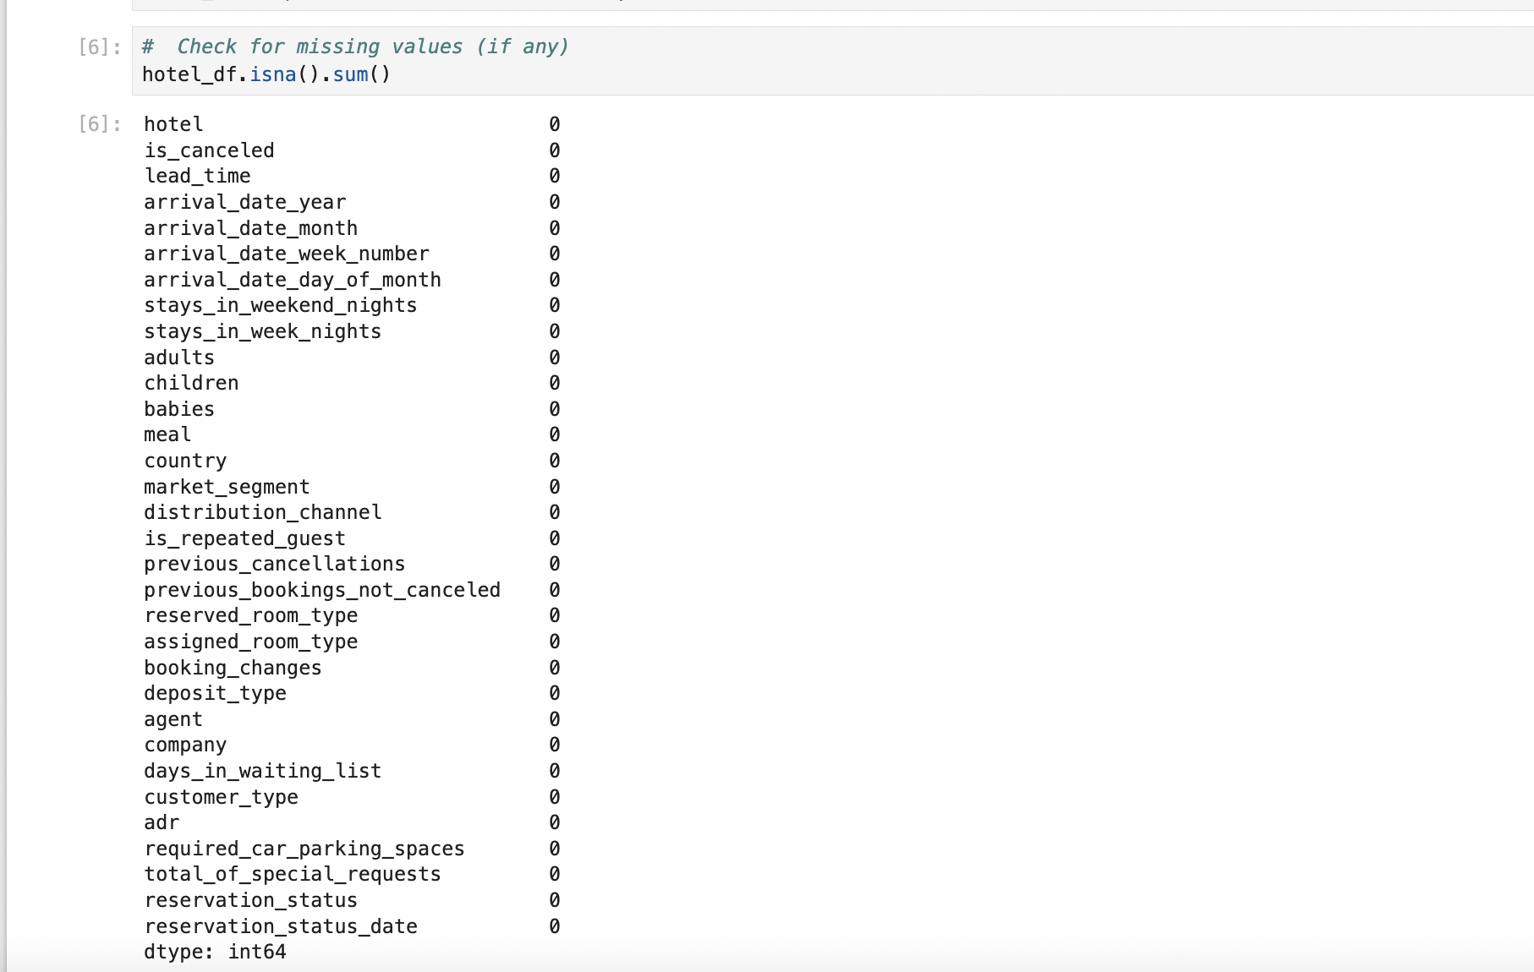
Preprocessing Data
Checking Missing Values:
To eliminate duplication in the Data Frame and to check for missing values, remove the 'Unnamed: 0' column, which is presumed to be an index column.

Slide 5
EDA Overview:
EDA had been done for the understanding of the dataset, pattern detection, and underlining of problems or issues related to the missing values, outliers, and correlations amongst the features in question.
1
Insights included, for one, how the increasing the lead times result in increasing cancellations; similarly, having a non-refundable deposit leads to lower cancellations; the booking online travel agent clients also appeared cancellative when related to the Direct/C Corporate guest type bookings.
2
The features for lead time and ADR had outliers, which were treated by the IQR method to avoid extreme values that might influence model predictions. Lastly, there was class imbalance; the non-canceled bookings were highly disproportionate compared to canceled, which is handled later by using SMOTE.
3
Bar charts, histograms, and correlation heatmaps on bookings trends gave further insights that helped to curate the feature selection process and improve model accuracy.
4

Slide 6
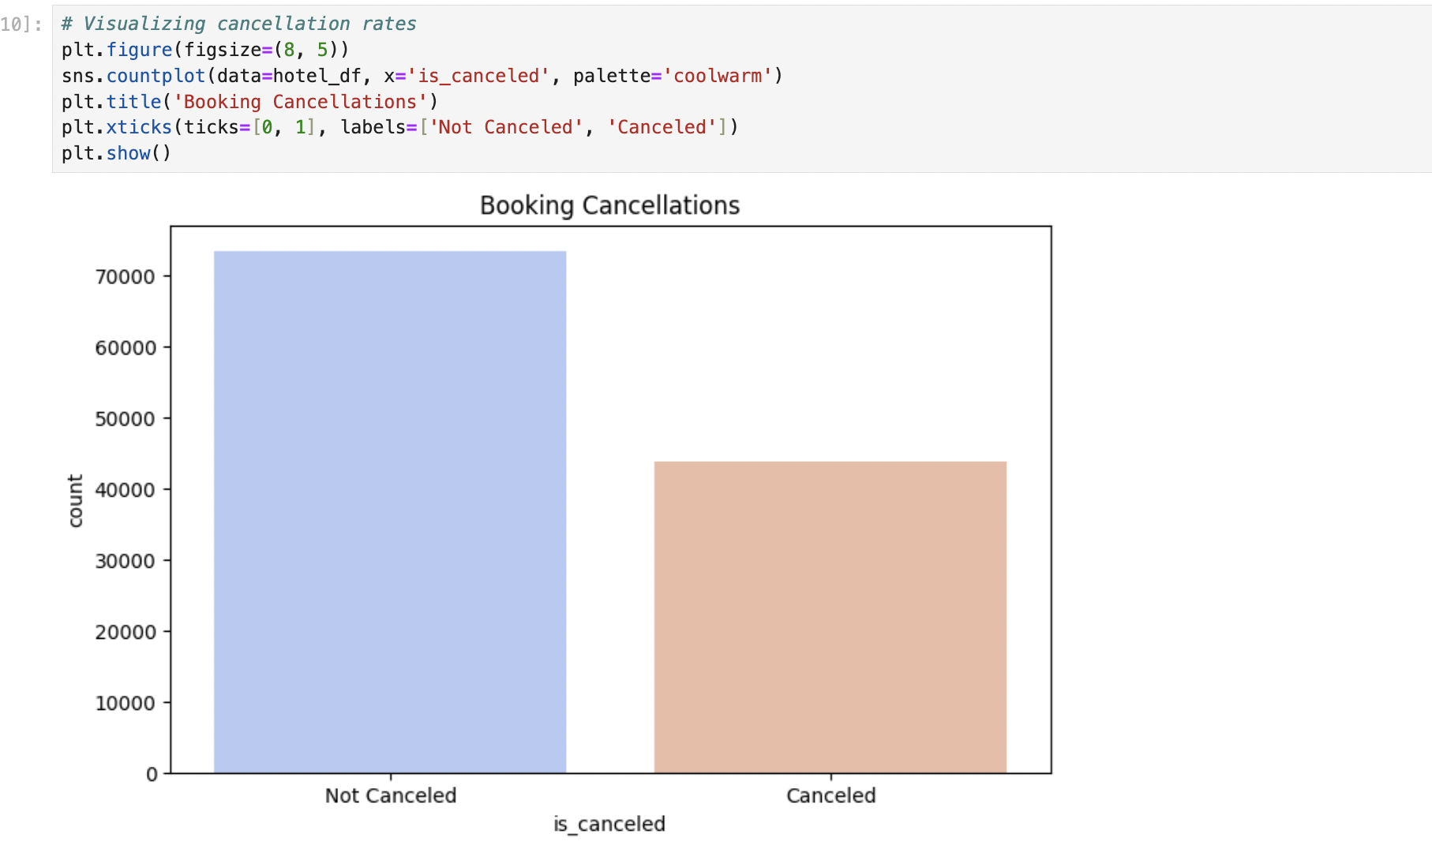
EDA (Exploratory Data Analysis)
Plot Cancellation Distribution
To understand the class distribution, visualize the distribution of 'is_canceled' using plot.

Slide 7
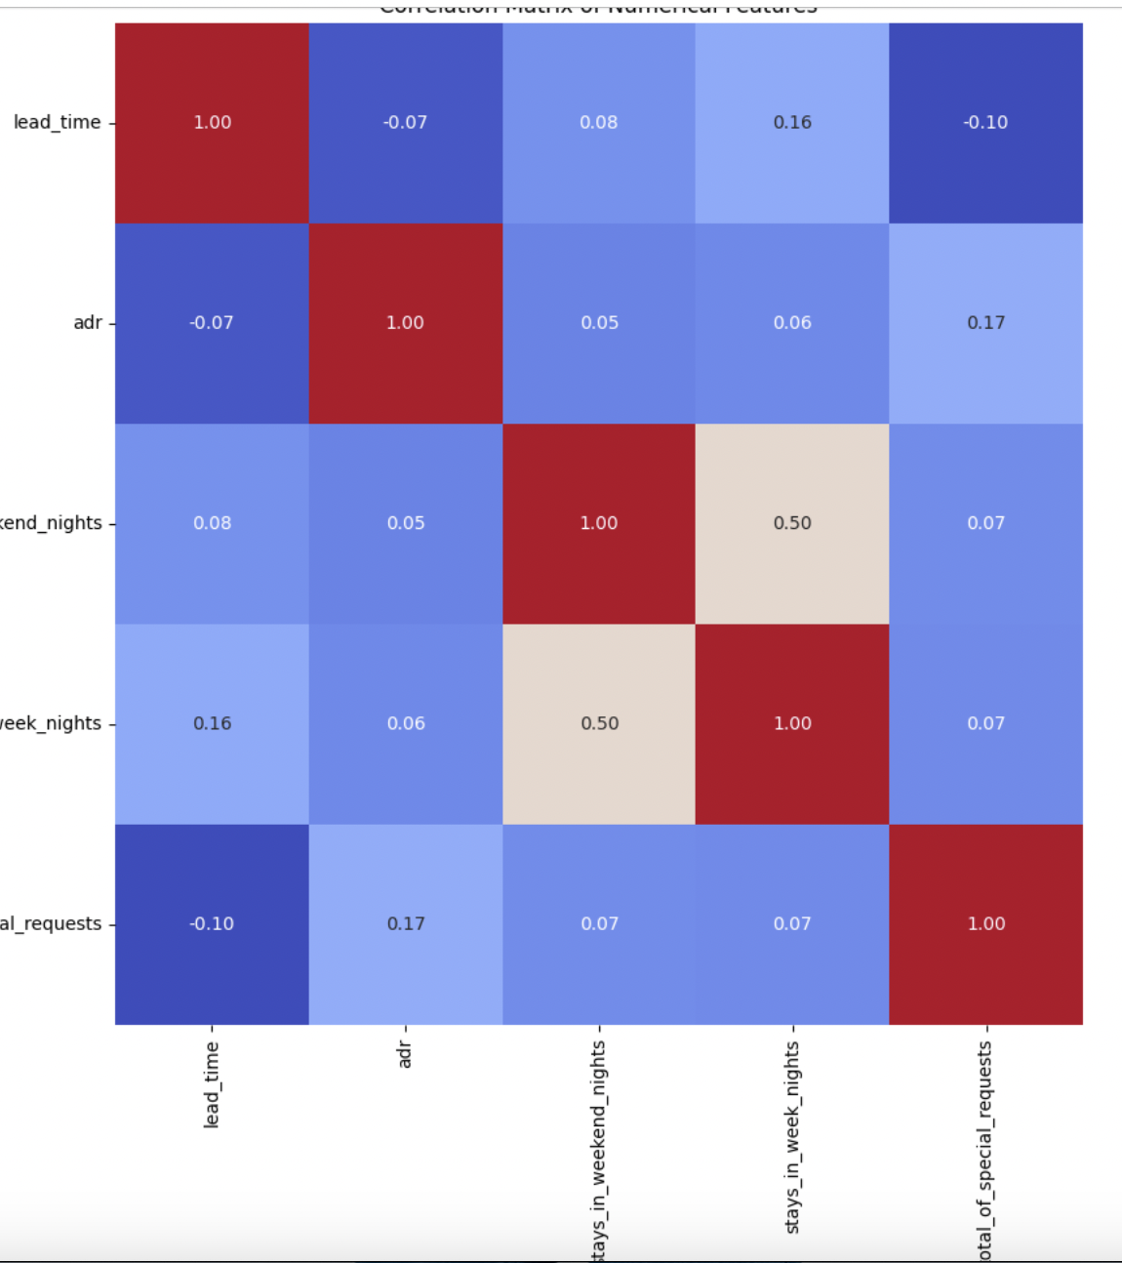
Correlation Heatmap:
To better comprehend feature associations, create a heatmap to represent the correlation matrix among numerical characteristics.

Slide 8
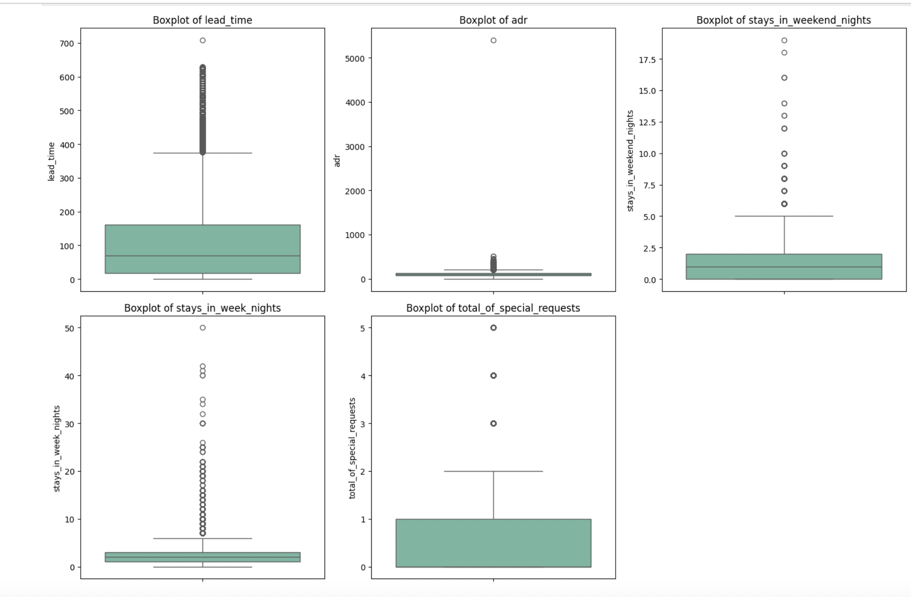
Outlier Detection:

Slide 9

Machine Learning Model Development
Several machine learning models, such as Random Forest, Logistic Regression, SVM, Decision Tree, and K-Nearest Neighbors, have been trained and tested for the prediction of hotel booking cancellations. Cross-validation has been used for each model to ensure the generalization of performance without overfitting.
Among these, SVM reached 95.8%, and Logistic Regression reached 95.7%, meaning that the cancellation patterns can be well captured by the linear relationship. Random Forest was also good, attaining 86.7%, leveraging its strength in handling complex feature interactions. K-Nearest Neighbors did moderately well, 81.7%, while Decision Tree had the worst result, 78.2%, probably due to its sensitivity to overfitting even when limiting depth.
Data leakage features were removed to improve model reliability, and class balancing was performed using SMOTE. The results of the models indicate that SVM and Logistic Regression are the best choices for predicting cancellations, offering high accuracy while maintaining generalizability.

Slide 10
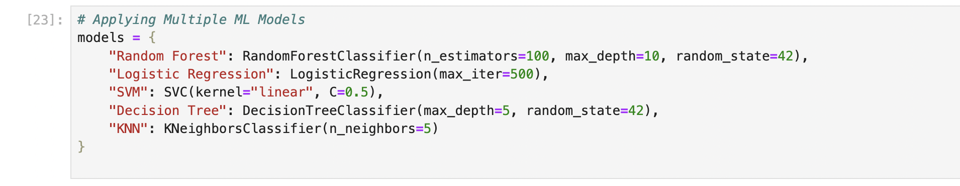
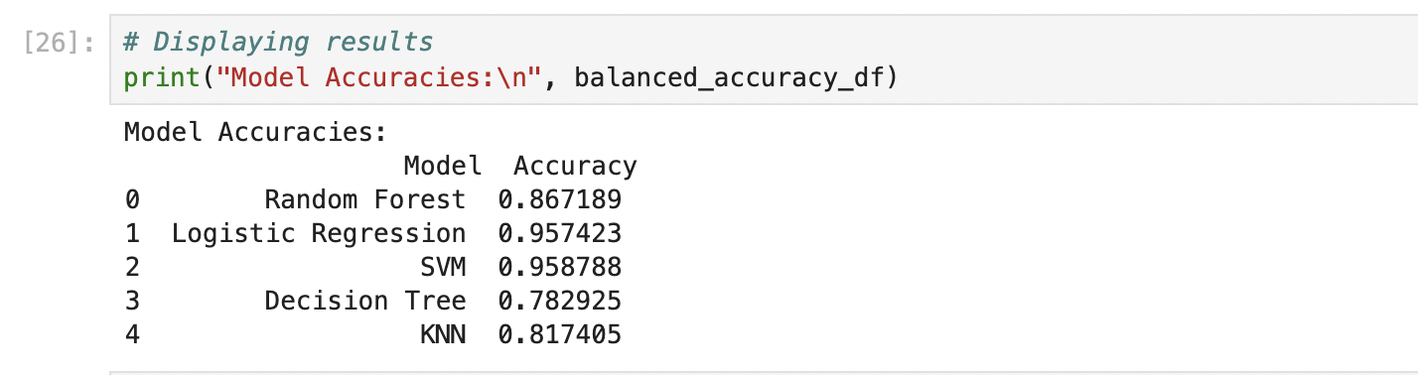

Slide 11

Model Evualtion and Confusion Matrix
The confusion matrix analysis provides deeper insight into how each model predicts cancellations and presents common misclassifications. Even though Logistic Regression and SVM showed the best results in terms of accuracy (96%), it also underlined possible misclassifications that might influence business decisions.
Some of the main problems are related to FNs, where actual cancellations are not predicted. Both Random Forest and KNN showed poor recall at 87% and 82%, respectively, missing certain cancellations by predicting them as non-canceled, which might have caused some unexpected losses to hotels in revenue from unoccupied rooms. The poorest recall value of 0.71 by Decision Tree at 78% misclassified many cancellations, which makes this classifier unreliable to predict cancellations.
On the other hand, Logistic Regression and SVM presented the lowest FPs, meaning they rarely signaled non-canceled bookings as cancellations. That is, these models issue fewer superfluous cancellation warnings and thus minimize operational disruptions for hotels. The trade-off, however, is that they still miss some actual cancellations (FN), which could be improved by adjusting the classification threshold.

Slide 12
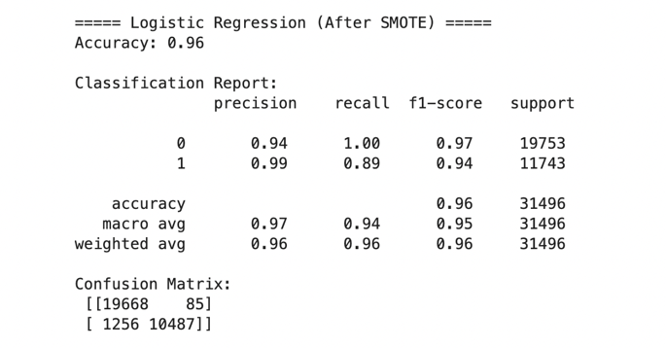
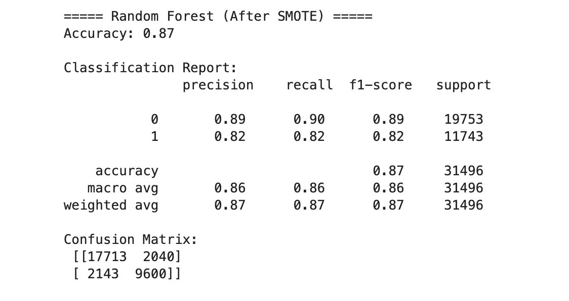
The reports of different algorithms can be seen below:

Slide 13
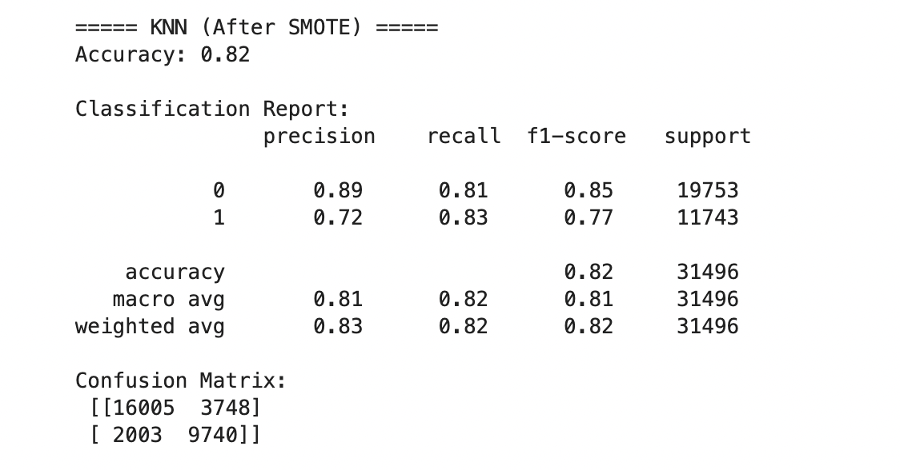
The reports of different algorithms can be seen below:

Slide 14
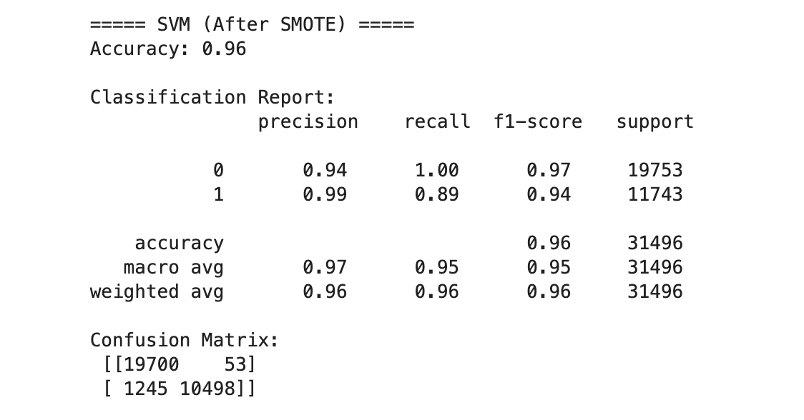
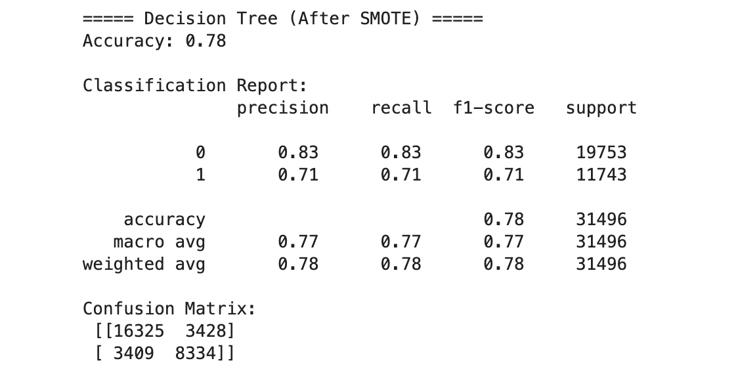
The reports of different algorithms can be seen below:

Slide 15
Insights and Recommendations
The output of this analysis provides a number of interesting strategies the hotels can try to minimize cancellations and maximize revenue. Since long lead-time bookings are more likely to cancel, hotels can apply dynamic pricing or deposit policies as incentives for guests to commit. In the same way, direct bookings may reduce cancellation rates compared with using online travel agencies for bookings.
For repeat guests who have a history of cancellation, hotels should develop loyalty programs that give rewards for completed stays. Further, insight into segment behaviors can refine booking policies, offering flexible cancellations to corporate travelers and enforcing stricter terms with transient guests.
With the help of machine learning predictions, hotels can take proactive approaches toward cancellations of bookings for better efficiency and revenue by optimizing room availability based on customer behavior trends.

Slide 16

Thank you

